Slide 1
U.C. Berkeley: Economics 115: Spring 2020
20th Century Economic History: Lecture 9: Fascism & WWII
Brad DeLong
Department of Economics and Blum Center, U.C. Berkeley; and WCEG
delong@econ.berkeley.edu
last revised: 2020-03-02
for delivery: M 2020-03-04 17:00 HMMB390
<https://bcourses.berkeley.edu/courses/1487684>
<https://github.com/braddelong/public-files/blob/master/econ-115-lecture-9.pptx>

Slide 2
About the Course
The long 20th century will in all likelihood be seen in the future as the watershed in human experience:
Nine aspects:
History was primarily economic—and that was true for the first time…
Explosion of wealth: 2%+ per year…
Cornucopia of technology…
Demographic transition…
Feminist revolution…
Empowered tyrannies…
Wealth gulfs…
Inclusion and hierarchy attenuation…
Mismanagement and insecurity…
Humanity is unlikely to see as transformative—for good and ill, but mostly for good, so far at least, I think—a century again…

Slide 3
Coronavirus!
Calls are Carol Christ’s…
That said:
If you are coughing and sneezing, stay home! Email me and we will give you extra-credit points…
Otherwise, there are powerful herd-animal benefits to coming to lecture
(& to talking about course material with your friends: you need to convince your brain that these concepts are useful, & it should keep them)
Washington State has been doing an intensive flu screening, so they know stuff:
They guess: 1 in 1500 people in WA has coronavirus right now
Half of them have no symptoms
Asymptomatic transmission means that we cannot contain this without shutting society down
Cases doubling every 5 days
Means that by the end of March 1 in 45 people in WA will have it…
April is likely to be epidemic-arrives month
In the end—whenever that comes—30%-70% of us will test positive
&, worldwide, 20 million people are likely to be dead
Our hope is to stretch out this process as long as possible, so that health providers are not totally overwhelmed
Oh. & iClicker base station broken: ordered a new one…

Slide 4
Preview
Fascism & WWII
Preview & review (5 min)
Administration (5 min)
Lecture: Continuing our look at mid-20th century lternatives to the ‘classical liberal’ laissez-faire order:
Fascism (10 min)
Adolf Hitler (10 min)
Review (20 min)
Lecture: WWII (20 min)
Takeaways from this lecture (5 min)
Preview of the next lecture (5 min)

Slide 5
Review: Takeaways from Last Time
From: Really-Existing Socialism
Give me three takeaways, & why they are important…

Slide 6
To Your iClickers
In the abortive German communist revolution of January 1919, Petty Officer Lemmgen and his forces failed to take control of the offices of the Ministry of War because:
Lieutenant Hamburger objected that the document authorizing him to do so was handwritten, and Lemmgen returned to Revolutionary HQ to get the document typed.
Lieutenant Hamburger objected that the document authorizing him to do so was not signed, and Lemmgen returned to Revolutionary HQ to get the document signed.
Lieutenant Hamburger objected that the Revolutionary Council that had produced the document was a bunch of traitors.
Lieutenant Hamburger objected that the Revolutionary Council was only made up of a minority of the leaders of the German Socialist Party.
None of the above.

Slide 7
Econ 115: Administration: Office Hours &c.
DeLong: Office Hours
M 11:10-12:40, Blum Hall 200B
T 11:15-12:00, Blum Hall 200B
By appointment in Blum Hall 200B, Evans 691A, or elsewhere: email <delong@econ.berkeley.edu> Sign up at: <https://www.icloud.com/numbers/0leoOOlezWp6BYKSiPJhdXy7Q>
Read: DeLong, chapter 11 & 12
Slides: <https://github.com/braddelong/public-files/blob/master/econ-115-lecture-8.pptx>
Do: Understanding the Great Depression <https://bcourses.berkeley.edu/courses/1487684/assignments/8052000>; due Mar 8
Memo: bCourses website <https://bcourses.berkeley.edu/courses/1487684>

Slide 8
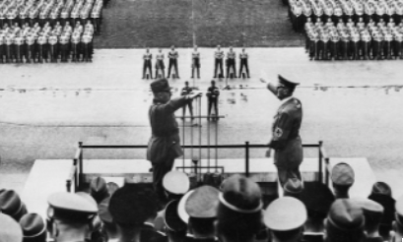
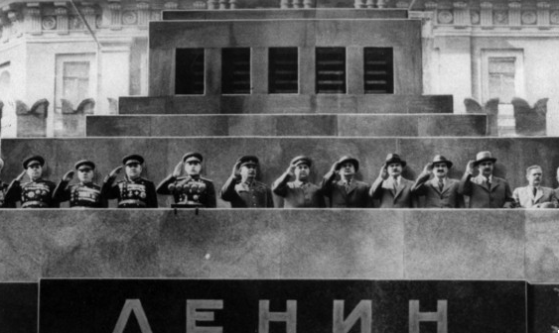
Fascism
Communism and Fascism: The Same or Different?
Felipe Fernandez-Armesto:
“From the perspective of the future, the differences among all forms of violent political extremism will blur.... Individuals moved between fascism and militant socialism as if by connecting channels. Mussolini was a socialist youth leader before he became a fascist duce....
“Many Nazis tried to make the party conform to its name: the National Socialist German Workers’ Party. Britain's [fascist leader], Oswald Mosley, was a socialist cabinet minister before he took to the streets....
“My father... carried a communist card and wore a [fascist] Falangist uniform [in Spain] at different moments in the 1930s…”
Is this fair?
Perhaps not…

Slide 9
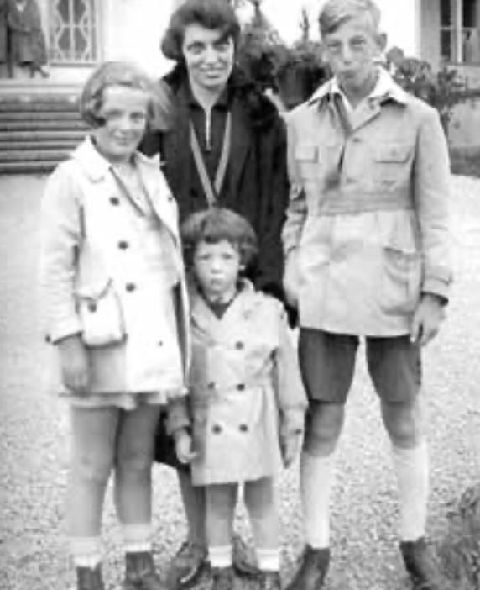
Fascism
Communism and Fascism: The Same or Different?
But perhaps it is fair…
Lifelong communist Eric Hobsbawm:
“To be a social revolutionary increasingly meant to be a… member or supporter of some Moscow-aligned Communist party.... Nobody else within sight offered both to interpret the world and to change it…. The communist movement…its unity, cohesion, and its striking immunity to fission, it was… the only game in town....
“Lenin’s ‘party of a new type’ [was] a formidable innovation of twentieth-century social engineering.... The party could command extraordinary devotion and self-sacrifice from its members, more than military discipline and cohesiveness, and a total concentration on carrying out party decisions at all costs.
“This impressed even hostile observers profoundly…”
This does not sound like Hobsbawm thinks he joined:
a movement that would change the world
because its intellectual mastery of the key to the riddle of history
gave it a lever
with which a small group could reshape the world for the best
This sounds, instead, like some fascist Triumph des Willens—a weak adolescent male convinced that joining a group that does stupid things makes him strong
But his attitude lasted Hobsbawm’s entire life…

Slide 10
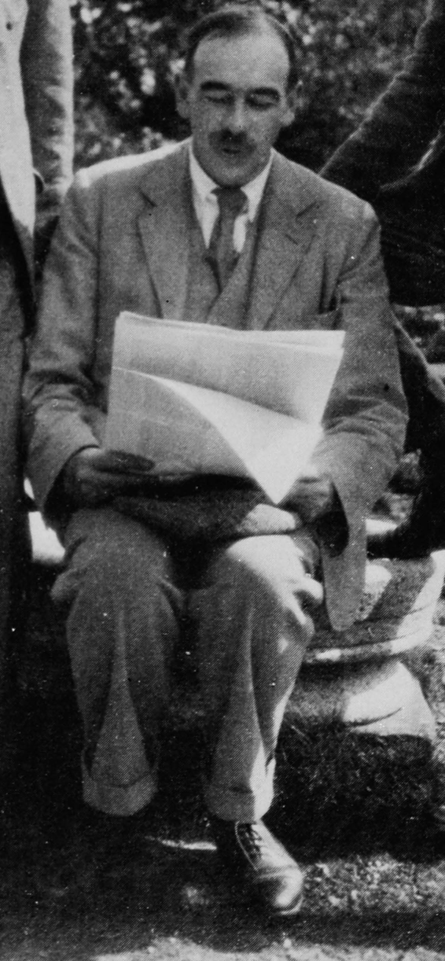
John Maynard Keynes’s Critique
General Theory, chapter 24:
Within this field the traditional advantages of individualism will still hold good…. The advantages to efficiency of the decentralisation of decisions and of individual responsibility is even greater, perhaps, than the nineteenth century supposed….
“Above all, individualism… is the best safeguard of personal liberty… widens the field for the exercise of personal choice… the best safeguard of the variety of life… the loss of which is the greatest of all the losses of the homogeneous or totalitarian state…. This variety preserves the traditions which embody the… successful choices of former generations… colours the present with the diversification of its fancy… and, being the handmaid of experiment… is the most powerful instrument to better the future….
“The authoritarian state systems of today seem to solve the problem of unemployment at the expense of efficiency and of freedom…. It may be possible by a right analysis of the problem to cure the disease whilst preserving efficiency and freedom…”
Review of Leon Trotsky:
“Granted his assumptions, much of Trotsky’s argument is, I think, unanswerable. Nothing can be sillier than to play at revolution…. [But] Trotsky’s book must confirm us in our conviction of the uselessness, the empty-headedness of Force at the present stage of human affairs…. We lack more than usual a coherent scheme of progress, a tangible ideal. All the political parties alike have their origins in past ideas and not in new ideas—and none more conspicuously so than the Marxists. It is not necessary to debate the subtleties of what justifies a man in promoting his gospel by force; for no one has a gospel. The next move is with the head, and fists must wait…”
A Short View of [Communist] Russia:
“There are three questions to answer. Is the new religion partly true, or sympathetic to the souls of modern men? Is it on the material side so inefficient as to render it incapable to survive? Will it, in the course of time, with sufficient dilution and added impurity, catch the multitude?… I sympathise with those who seek for something good in Soviet Russia. But … for me… Red Russia holds too rnuch which is detestable…. I am not ready for a creed which does not care how much it destroys the liberty and security of daily life, which uses deliberately the weapons of persecution, destruction, and international strife… suborn[s] spies in every family and group…. Perhaps this is no worse and has more purpose than the greedy, warlike, and imperialist propensities of other governments; but it must be far better than these to shift me out of my rut.
“How can I accept a doctrine which sets up as its bible, above and beyond criticism, an obsolete economic textbook which I know to be not only scientifically erroneous but without interest or application for the modern world?…”

Slide 11
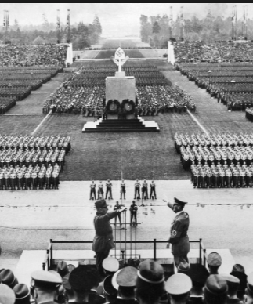
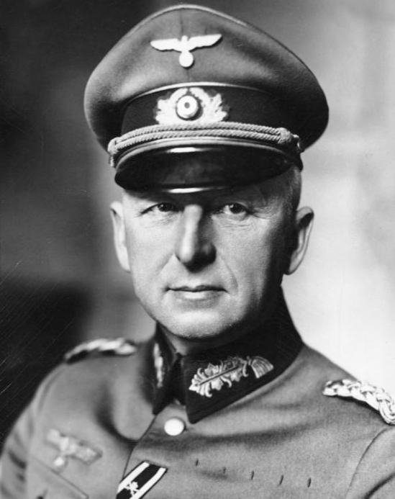
Key Elements of Fascism
A belief in leaders: good politics sees not representatives expressing the desires of those below; but leaders who command; the goals of a country are imposed by leaders of vision from above.
The cretinism of parliaments: Composed of time-servers, corrupt distributors of favors to special interests, or ideological champions, they are simply incompetent to handle the problems of modern life.
A belief in the value of a strong and unified nation: the willing and eager sacrifice of individual goals and lives to strengthen the national purpose, with war and expansion as tests of strength and arenas for heroic sacrifice.
“Coordination and propaganda”: advertising, ceremonies, the ruling party as an enforcer of social discipline and respect for the leader.

Slide 12
Key Elements of Fascism II
A belief in at least some traditional hierarchies: the army, the family, sometimes the church.
A hatred of social justice warriors: socialists as opponents of national self-assertion (and as potential betrayers of the people to slavery under a foreign—usually Jewish or Communist or Russian or all three elite); liberals as unwilling to take the steps necessary to fight socialists, as self-absorbed individualists who weakened the nation, and as parliamentarians who did not recognize that the nation, not the individual, held rights.
A hatred of Jews: rootless cosmopolitans uninterested in the ethnic or national identity and destiny; thieves and deceivers to boot; people who made their money through financial manipulation rather than heroic feats of engineering and construction.
Unity is achieved through demonizing enemies: political order not as contract, cooperation, or fellowship—but as war against “others”, our of which the only true fellowship can grow

Slide 13
Adolf Hitler: His Rise to Power
Adolf Hitler rose to power as an anti-communist who had a plan:
to deal with the Great Depression
to deal with German subservience to the World War I Allied powers
to deal with the “November criminals”, the Jews, and the other enemies of the German Volk
to turn Germans into a Herrenvolk
The only politician who was charismatic, conservative, populist, and a man-with-a-plan
He rose to power because he was all four
No Great Depression, no Nazi state

Slide 14
No Great Depression, No Nazi State
The second saddest book on my bookshelf: Hugh Quigley & Robert Clark (1928): Republican Germany: A Political and Economic Study:
“The consolidation of the German [Weimar] Republic is in itself a theme of the most absorbing interest....
“The fifth and probably last act is now being played, and promises something… heartening….
“The real consummation will probably be reached—namely, the recognition of the German Republic as a permanent feature in German history and its economic and political relations, and, with it, the opening of a new era of international prosperity….
Quigley and Clark’s—long—book contains three mentions of Adolf Hitler:
a passing reference to the “Hitler incident”,
a half- page narrative of Hitler’s unsuccessful 1923 attempt to take over the Bavarian provincial government via a coup
“Bavaria… was an armed camp… organizations for military training and (what was more deadly) secret societies in morality and mentality far more akin to the worst traditions of medievalism than to those of the twentieth century…. The movement dominated by the military element… was illumined by the names of Ludendorff and Hitler…”
Writing in 1928, five years before Hitler was to take power and destroy the German Republic, Adolf Hitler is simply not a big deal to two people writing a political and economic survey of Germany…

Slide 15
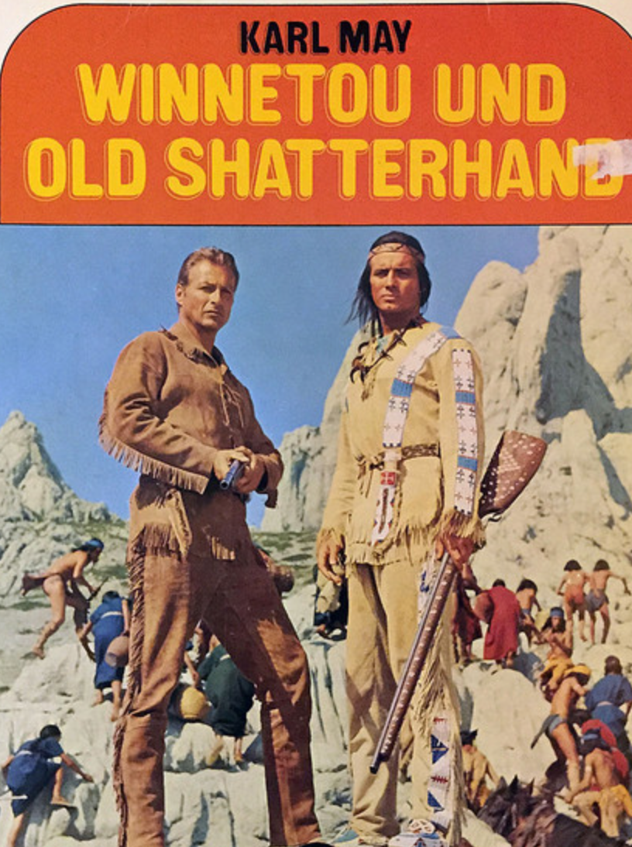
Adolf Hitler’s Malthusianism
How to turn Germans into a Herrenvolk?
Adolf Hitler really hated Jews
Adolf Hitler had read too many cowboy novels by Karl May
Adolf Hitler took Malthus very seriously:
“Germany has an annual increase in population of nearly nine hundred thousand souls. The difficulty of feeding this army of new citizens must grow greater from year to year and ultimately end in catastrophe.... There were four ways of avoiding so terrible a development…”

Slide 16
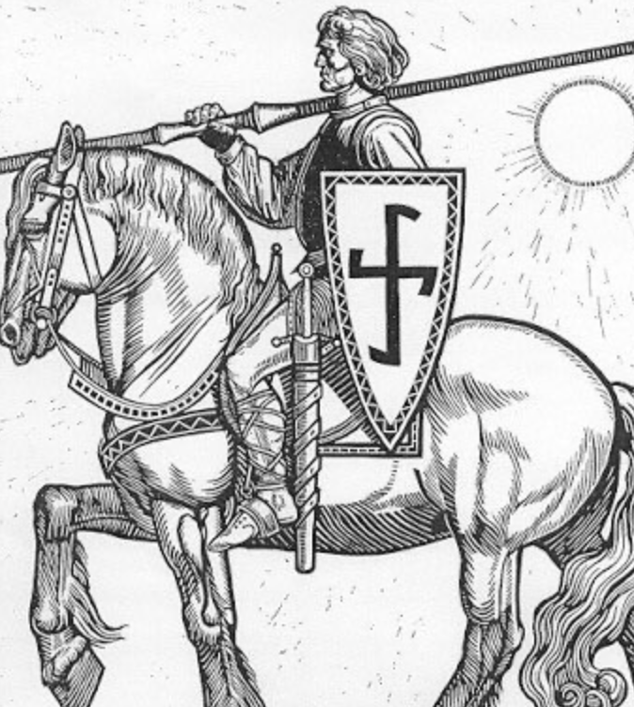
Four Ways Out…
Birth control? That’s worse…
Agricultural productivity? Limited effect…
Export manufactures? “Unhealthy”—and incredibly risky given the British fleet…
“Living space”: Conquest and demographic replacement
Germany in a long-run fight for world domination with:
Britain
Russia
America
China? India?

Slide 17
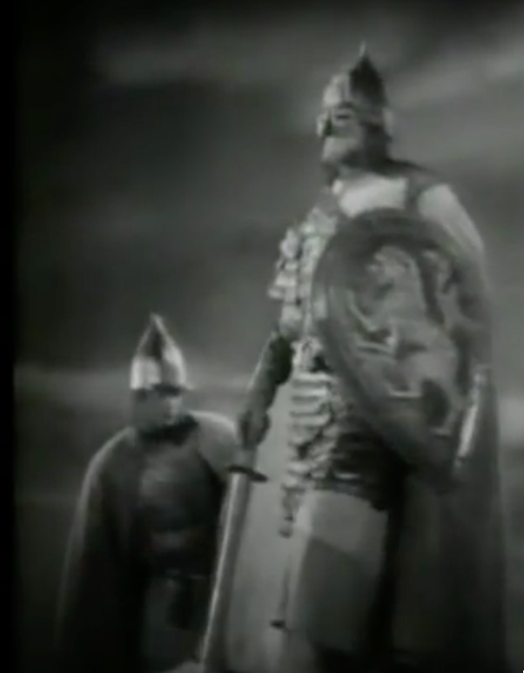
Drang nach Osten!
Adolf Hitler:
“We must... coolly and objectively adopt the standpoint that it can certainly not be the intention of Heaven to give one people fifty times as much land and soil in this world as another.... We must not let political boundaries obscure for us the boundaries of eternal justice….
“The law of self-preservation goes into effect; and what is refused to amicable methods it is up to the fist to take… If land was desired in Europe, it could be obtained by and large only at the expense of Russia….
“The new Reich must again set itself on the march along the road of the Teutonic knights of old, to obtain by the German sword sod for the German plow and daily bread for the nation…”

Slide 18
Drang nach Osten! II
Max Weber, a German liberal:
“The German character of the East [is] something that should be protected…. Our state is a national state, and... we have a right to make this demand…. The economic struggle between the nationalities follows its course even under the semblance of 'peace'. The German peasants and day-labourers of the East are… getting the worst of it in the silent and dreary struggle of everyday economic existence… abandoning their homeland to a race which stands on a lower level….
“Here can be no truce even in the economic struggle for existence…. Certainly the vulgar conception of political economy is that it consists in working out recipes for making the world happy…. However [reality] prevents us from imagining that… elbow-room in this earthly existence can be won in any way than through the hard struggle.... The question... is not 'how will human beings feel in the future' but 'how will they be'....
“We do not want to train up feelings of well-being in people, but rather those characteristics we think constitute the greatness and nobility of our human nature….
“Our successors will not hold us responsible before history for the kind of economic organization we hand over to them, but rather for the amount of elbow-room we conquer for them in the world…”
Erich von Manstein, nee von Lewinsky…

Slide 19
Review
Let’s remind ourselves of the salient landmarks from five of our classes so far:
The “broad sweep” of long 20th century economic history
1870 as the inflection point (plus American ascendancy)
Economic mismanagement and insecurity—the political economy of the long 20th century
The Belle Époque broken
Why was the Great Depression so great?

Slide 20
Review: Broad Sweep: To Your iClickers
What was the growth rate of the value of ideas in the industrial core of the world economy over 1870-2020?
About 2.1%/year
About 0.9%/year
About 0.44%/year
About 4%/year
None of the above

Slide 21
To Your iClickers
What was the growth rate of the value of ideas in the industrial core of the world economy over 1770-1870?
About 2.1%/year
About 0.9%/year
About 0.44%/year
About 0.04%/year
None of the above

Slide 22
To Your iClickers
What was the growth rate of the value of ideas in the world economy as a whole over 1870-2020?
About 2.1%/year
About 0.9%/year
About 0.44%/year
About 4%/year
None of the above

Slide 23
To Your iClickers
What was the growth rate of the value of ideas in the world economy as a whole over 1770-1870?
About 2.1%/year
About 0.9%/year
About 0.44%/year
About 4%/year
None of the above

Slide 24
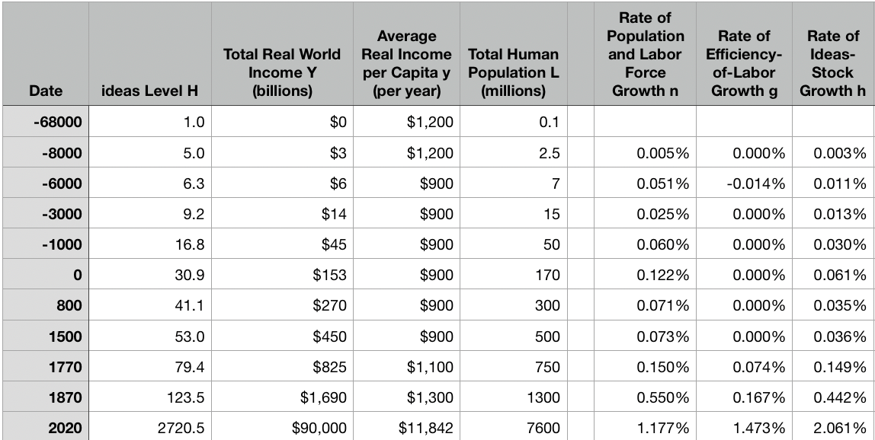
Review: The Broad Sweep
Post-1870 is the miracle:

Slide 25
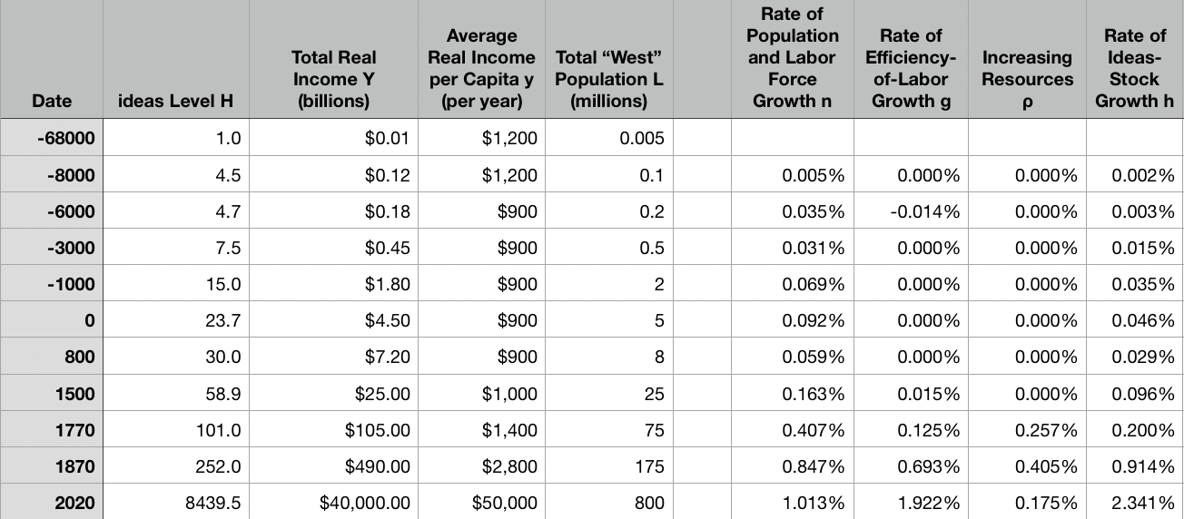
“The West”
Separate path begins in 800, 1500, 1770, or 1870?:

Slide 26
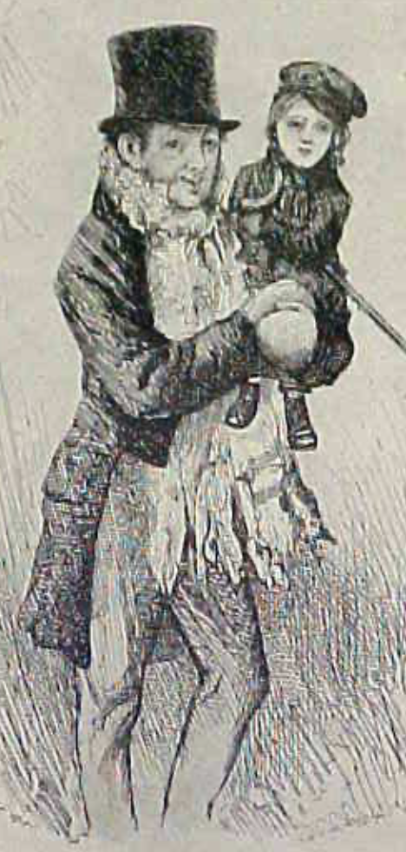
Review: 1870 as an Inflection Point
As of 1870, had the Industrial Revolution raised the standard of living or lightened the toil of the working class in England, the country at its center?
Yes
No
It’s not clear
Why? Malthusian forces—population explosion & thus smaller farm sizes. Growth, the growth had been slow 0.8%/year?

Slide 27
Globalization
Who called the era of globalization and growth from 1870 to 1914 an “economic El Dorado”?
Karl Marx
John Stuart Mill
Thomas Robert Malthus
John Maynard Keynes
None of the above
What would the others have said?

Slide 28
Migration
How many people of the roughly 1.5 billion then-population of the world left their continents of origin between 1870-1913?
10 million
50 million
100 million
200 million
400 million

Slide 29
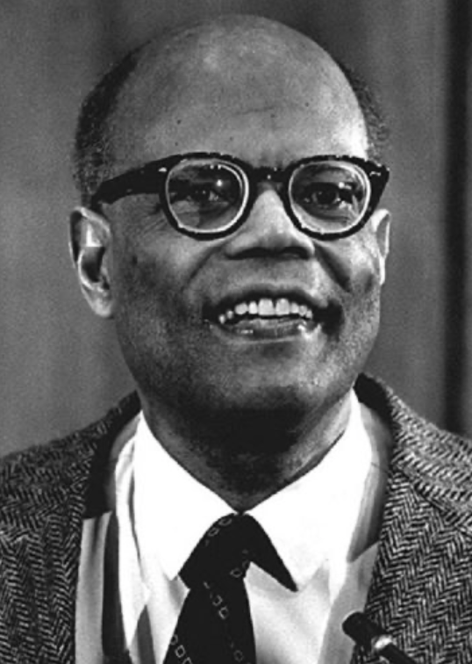
The Last Growth Acceleration
The industrial research lab to routinize invention, and the modern corporation to routinize diffusion and deployment
Plus general purpose technologies—machine tools, non-human power sources
Arthur Lewis:
“New commodities: telephones, gramophones, typewriters, cameras, automobiles, and so on, a seemingly endless process whose latest twentieth-century additions include aeroplanes, radios, refrigerators, washing machines, television sets, and pleasure boats. Thus a rich man in 1870 did not possess anything that a rich man of 1770 had not possessed; he might have more or larger houses, more clothes, more pictures, more horses and carriages, or more furniture than say a school teacher possessed, but as likely as not his riches were displayed in the number of servants whom he employed rather than in his personal use of commodities…”
Not so much the particular technologies, as the grasping of the fact that there was a broad and deep range of new technologies to be discovered.
As much as it was new technologies, it was large-scale corporate organizations that could and did plan the division of labor to make use of and then market technologies.
And as much, it was that the global market meant that there was now a great deal of money to be made from the routinization of the exploration, development, and deployment of technological possibilities

Slide 30
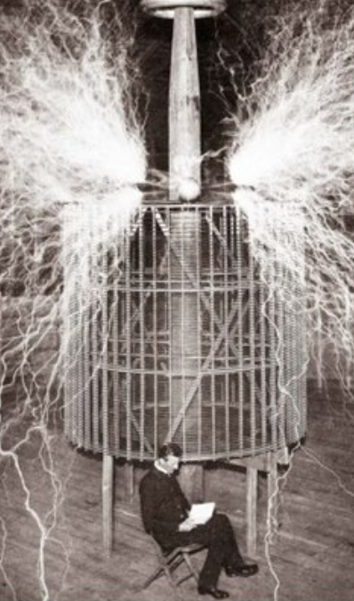
Who Is This Man?
And is he in any real danger?
Thomas Edison, and no
Andrew Carnegie, and no
Nicola Tesla, and no
Thomas Edison, and yes
Herbert Hoover, and yes

Slide 31
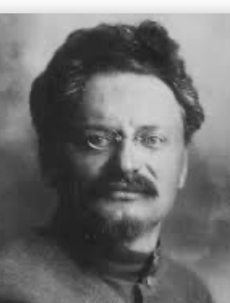
American Ascendancy: Lev Bronstein
Why did he say this?
“I had had no time to more than catch the general life-rhythm of the monster known as New York…”
“I left for Europe with the feeling of a man who has had only a peek into the furnace where the future is being forged…"

Slide 32
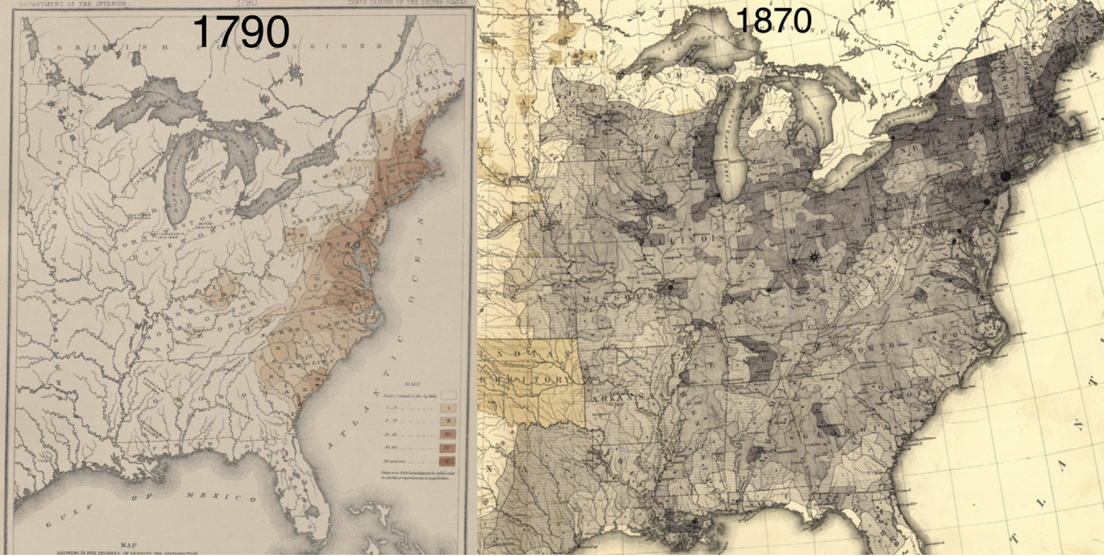
Westward Expansion
http://bradford-delong.com brad.delong@gmail.com

Slide 33
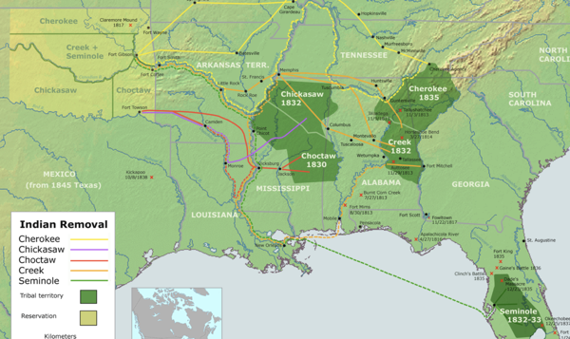
“Trail of Tears’
http://bradford-delong.com brad.delong@gmail.com

Slide 34
The Importance of Resources 1760-1860
Thus if γ→∞ then h=0.010
Thus if γ=3.0 then h=0.00667
Thus if γ=1.0 then h=0.00
Looking across the Atlantic Ocean to Great Britain, we see that over there it is indeed the case that h=0.005 from 1760 to 1860. Faster growth of h in America due to some catchup with the world's first and leading industrial nation seems likely. So γ=3.0 has some claim to be the most likely value…
http://bradford-delong.com brad.delong@gmail.com

Slide 35
A large chunk of America's pre-1860 visible growing prosperity was based not just on African-American slavery, but also on "Amerindian removal"
http://bradford-delong.com brad.delong@gmail.com

Slide 36
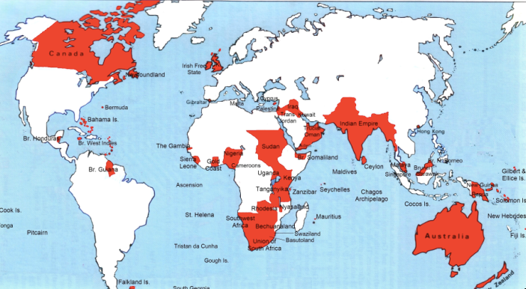
Empire

Slide 37
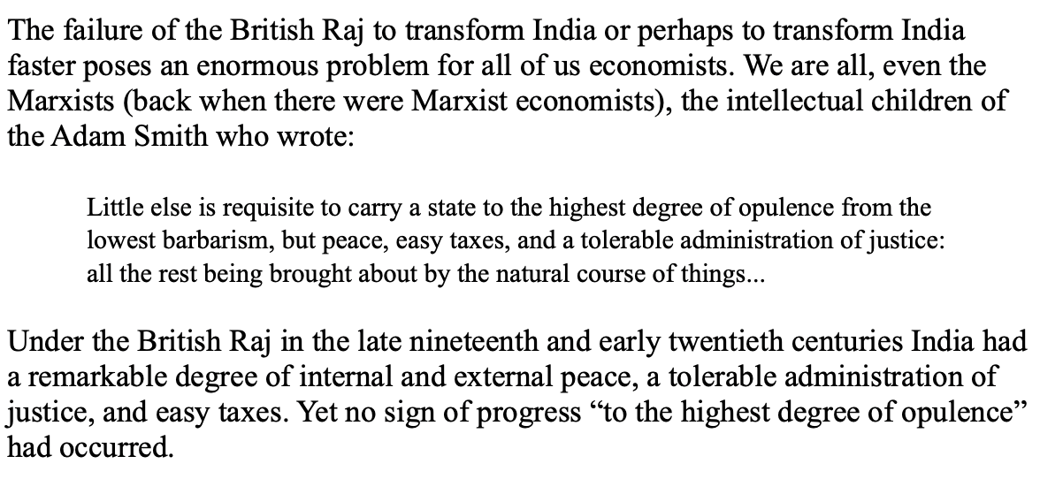
India
Why didn’t the British transform India into an industrial power?

Slide 38
Inclusion and Hierarchy Attenuation
At the start of the 1970s, future President Ronald Reagan said that diplomats from Tanzania appeared uncomfortable:
resisting pressure to vote with the Soviet Union at the United Nations.
making small talk with New York socialites.
wearing shoes.
in formal tuxedos.
None of the above.

Slide 39
Review: Economic Mismanagement and Insecurity
According to Karl Polanyi, what rights does the market economy respect?
rights to land (a stable community).
rights to labor (a “just” income).
rights to finance (a stable economic place).
rights to property (the ability to keep what you manage to claim to earn).
None of the above.

Slide 40
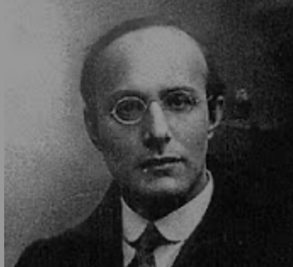
Popular Government and the Market Economy: Society’s Revenge
Karl Polanyi
People believe they have rights—to stable, supportive, nurturing communities; to incomes commensurate with their skills and status; and to money flows that will provide economic stability…
But a market society turns these things—land, labor, and finance—into commodities…
But they are not real commodities, they are fictitious commodities
And so you get your rights only if they satisfy a market profitability test
The only rights a market society respects are property rights:
& the only property rights that are worth anything are those that help you produce things for which rich people have a serious jones
Society will have its revenge: it will protect itself against the market logic, somehow, some way…

Slide 41
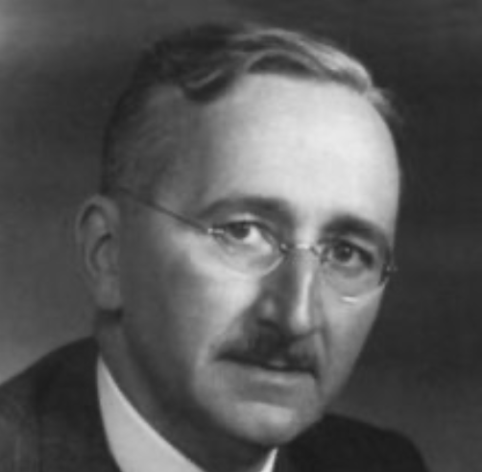
Hayek and Polanyi
Thumbnails on our first two:
Hayek:
Only the market economy can use society’s knowledge.
But the market economy cannot produce “social justice” and should not be asked to try—in fact, we need to recognize that all we can attain is freedom, and that will bring general prosperity, but that justice will be forever outside our reach
Polanyi:
The market economy turns land, labor, and finance into “fictitious commodities”
Society will have its revenge via a “double movement”

Slide 42
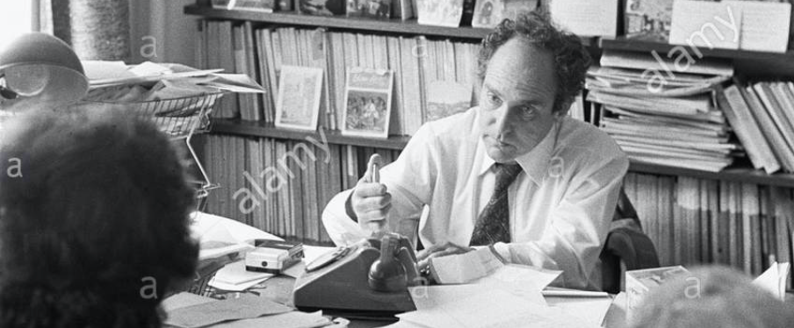


Digression: 5 Thinkers
Who shape my thought about the long 20th century—and how should, I think, shape yours
Beware! They are all deeply flawed…
But they are also geniuses, each in his way…
Beware of their followers! An iron law of ideology: a thinker’s most extravagant and aggressive followers will latch onto the stupidest and most shortsighted and wrong of their doctrines…
In historical order: Marx, Keynes, Hayek, Polanyi, Gellner
The other three thinkers:
Keynes: All that we need to produce general prosperity is technical adjustments to our system. Then the kingdom of freedom and prosperity will be within our grasp—and our major problems will no longer be economic ones
Gellner: The energy that most 19th century thinkers thought would go to “class“ went to “ethnos“ or “umma“ instead. The construction of ideological legitimations that makes sense both to dominants and to submissives who nevertheless believe they are part of some in-group is the key to understanding how societies stabilize themselves
Marx: Only the market economy will focus society’s energy on paying through the nose to boost the economy’s capital stock and to harvest the fruits of science and technology and then deploy them in production. But because the only demands in a market economy that matter are effective demands, the market economy also becomes a more “effective” means of slavery, for private property leads the proletariat to enslave themselves

Slide 43
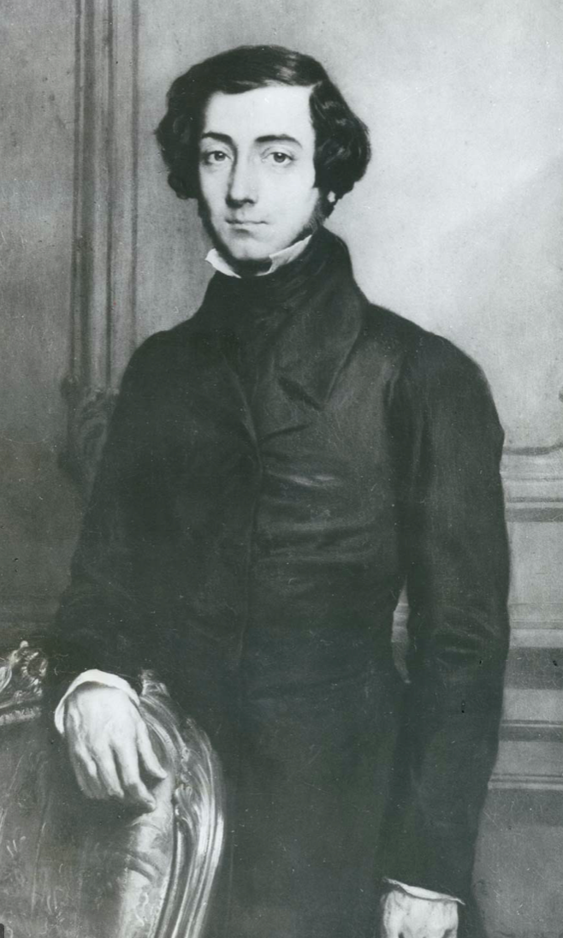
Plus: Tocqueville
Toqueville on the rich as “elder brothers” in 1848:
“In the country all the landed proprietors, whatever their origin, antecedents, education or means, had come together, and seemed to form but one class: all former political hatred and rivalry of caste or fortune had disappeared from view. There was no more jealousy or pride displayed between the peasant and the squire, the nobleman and the commoner; instead, I found mutual confidence, reciprocal friendliness, and regard. Property had become, with all those who owned it, a sort of badge of fraternity. The wealthy were the elder, the less endowed the younger brothers; but all considered themselves members of one family, having the same interest in defending the common inheritance. As the French Revolution had infinitely increased the number of land-owners, the whole population seemed to belong to that vast family. I had never seen anything like it, nor had anyone in France within the memory of man…”
“The territorial aristocracy of past ages… [was] obliged… to come to the help of its servants and relieve their distress” no such reciprocal ties of obligation bound the aristocrats of manufactures to their workers: thus “the manufacturing aristocracy which we see rising before our eyes is one of the hardest that have appeared on the earth…”

Slide 44
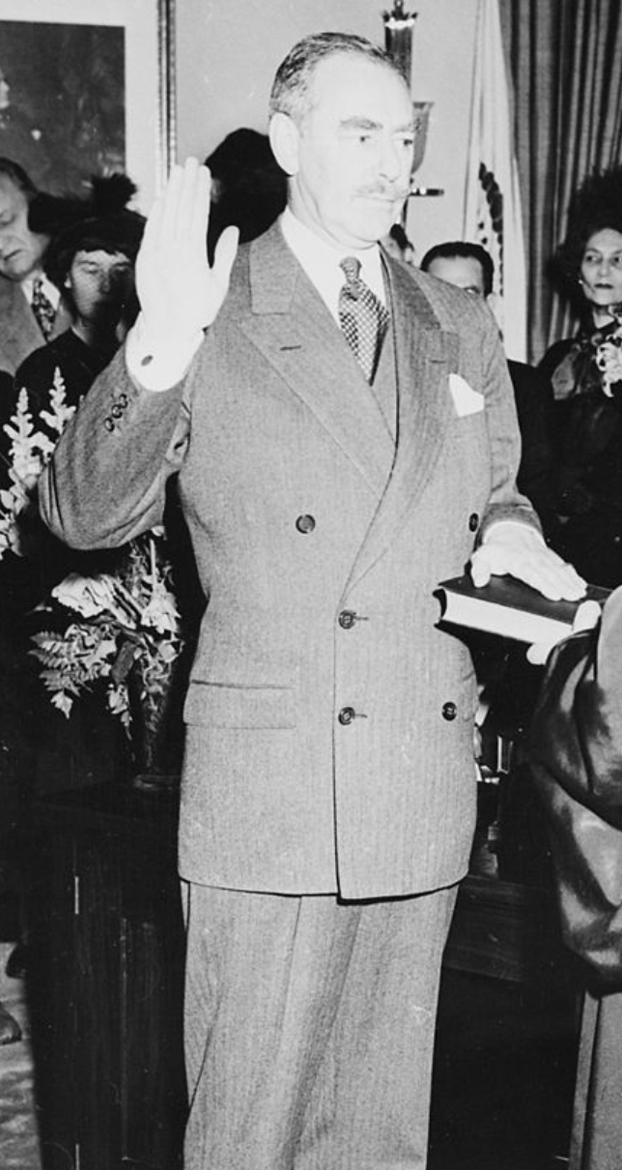
Plus: Acheson
Dean Acheson, Secretary of State for Harry S Truman:
On the Republican Party as the party of wealth, enterprise, and opportunity:
“This business base of the Republican Party is stressed not in any spirit of criticism. The importance of business is an outstanding fact of American life. The achievements of business have been phenomenal. It is altogether appropriate that one of the major parties should represent its interests and its point of view…”
The subsequent transformation of the Republican Party from those who were going to become millionaires, or become even greater millionaires; to those who fear that they would lose it all…

Slide 45
Review: The Belle Époque Broken
John Maynard Keynes:
“Very few of us realise[d] with conviction the intensely unusual, unstable, complicated, unreliable, temporary nature of the economic organisation by which Western Europe has lived for the last half century. We assume some of the most peculiar and temporary of our late advantages as natural, permanent, and to be depended on, and we lay our plans accordingly.
“On this sandy and false foundation we scheme for social improvement and dress our political platforms, pursue our animosities and particular ambitions, and feel ourselves with enough margin in hand to foster, not assuage, civil conflict in the European family....
“France, Germany, Italy, Austria, and Holland, Russia and Roumania and Poland, throb together, and their structure and civilisation are essentially one. They flourished together, they have rocked together in a war which we, in spite of our enormous contributions and sacrifices (like though in a less degree than America), economically stood outside, and they may fall together…”

Slide 46
Keynes’s Protest
Jan Christian Smuts:
“Poor Keynes often sits with me at night after a good dinner and we rail against the world and the coming flood. And I tell him that this is the time for Grigua’s prayer (the Lord to come himself and not to send his Son, as this is not a time for children). And then we laugh, and behind the laughter is [Herbert] Hoover’s horrible picture of thirty million people who must die unless there is some great intervention. But then again we think that things are never really as bad as that; and something will turn up, and the worst will never be. And somehow all these phases of feeling are true and right in some sense…”

Slide 47
Keynes’s Protest II
John Maynard Keynes:
“If we aim deliberately at the impoverishment of Central Europe, vengeance, I dare predict, will not limp. Nothing can then delay for long that final civil war between the forces of reaction and the despairing convulsions of revolution, before which the horrors of the late German war will fade into nothing, and which will destroy... the civilization and progress of our generation…”

Slide 48
Aristocracy & Social Democracy
The aristocrats had rolled the dice:
Europe in 1914 was a Europe of national populations, of industrialists and socialists, of factory workers and technicians…
Europe’s governments in 1914—especially the defense and foreign affairs ministries—had been populated by aristocrats, ex-aristocrats, and would-be aristocrats.
Landed, aristocratic, military elites had control of many of the levers of propaganda and power…
Aristocrats had had help. Industrialists and entrepreneurs were eager to provide their political support in return for economic benefits, as in the 1879 German “marriage of iron and rye”: the imposition of tariffs on imports of British steel (to protect the positions of German manufacturers) and on imports of American grain (to protect the positions of German landlords)…
On the eve of World War I, these landed military service aristocrats, ex-aristocrats, and would-be aristocrats increasingly found themselves members of a social caste that had no societal function…
But power—in the form of office and of vast (if declining relative) wealth—and propaganda—in the form of pageantry and the press—were reinforced by ideologies: Social darwinism…
The aristocrats rolled the dice—and lost…
Social democrats picked up the chips:
Expanded suffrage…
Proportional representation…
“Lands fit for heroes…”
How to provide for the benefits politicians promised?

Slide 49
Review: Why Was the Great Depression so Great?
John Maynard Keynes:
“When once the recovery has been started, the manner in which it feeds on itself and cumulates is obvious. But during the downward phase, when both fixed capital and stocks of materials are for the time being redundant and working-capital is being reduced, the schedule of the marginal efficiency of capital may fall so low that it can scarcely be corrected, so as to secure a satisfactory rate of new investment, by any practicable reduction in the rate of interest.
“Thus with markets organised and influenced as they are at present, the market estimation of the marginal efficiency of capital may suffer such enormously wide fluctuations that it cannot be sufficiently offset by corresponding fluctuations in the rate of interest. Moreover, the corresponding movements in the stock-market may, as we have seen above, depress the propensity to consume just when it is most needed. In conditions of laissez-faire the avoidance of wide fluctuations in employment may, therefore, prove impossible without a far-reaching change in the psychology of investment markets such as there is no reason to expect.
“I conclude that the duty of ordering the current volume of investment cannot safely be left in private hands….”

Slide 50
General Glut
How is it that there can be a "general glut" in which pretty much every produced commodity and the labor of workers are in excess supply, given that humans are far from satiated with production goods and given that one person's expenditure is another person's income?
Remember: you can take your income and use it either to buy things that are useful or to build up your stock of cash money. If there is excess demand for useful commodities, people can switch from producing whatever they were making to producing whatever is in short supply.
But the only way to build up your stock of cash is to try to cut your spending below your income. And since one person's spending is another person's income, that simply cannot be done in general.
If people in general try, the result is that spending and incomes fall economywide until they are both at such a low level that people de-prioritize building up their cash holdings.

Slide 51
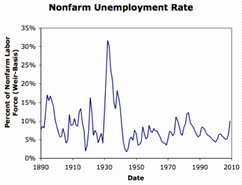
What Had Ended Previous Downturns?
Previous Cycles:
1873—RR investment drops to zero
1884—RR investment drops to zero
1893—confidence that gold standard will be kept
1904—Theodore Roosevelt
1907—J.P. Morgan constitutes himself a pick-up central bank
1914—profits from European war demand WWI
1920—Federal Reserve reverses course

Slide 52
The Hoover Administration’s Reaction to the Great Depression
The 1929-1933 Hoover administration believed that little could be done.
That the only good things that could be done were to (a) repeatedly state that "prosperity is just around the corner" and (b) try to cut federal government spending and raise taxes in order to restore confidence and scotch the fear of high inflation.
As economist R.G. Hawtrey wrote, to worry about inflation in the midst of the Great Depression was like "crying 'FIRE! FIRE!' in Noah's Flood..."
Herbert Hoover himself wrote afterwards about how his administration had been dominated by the "'leave-it-alone liquidationists' headed by Secretary of the Treasury Mellon, [who] felt that government must keep its hands off and let the slump liquidate itself. Mr. Mellon had only one formula:
'Liquidate labor, liquidate stocks, liquidate the farmers, liquidate real estate'. He held that even panic was not altogether a bad thing. He said: 'It will purge the rottenness out of the system. High costs of living and high living will come down. People will work harder, live a more moral life. Values will be adjusted, and enterprising people will pick up the wrecks from less competent people'…"
Hoover went on to state that he did not share this view…
That raises lots of questions about how his administration worked…

Slide 53
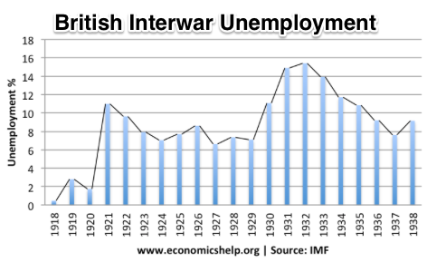
“Crying ‘Fire! Fire!’ in Noah’s Flood…”
France gold acquisition policy
American gold acquisition policy
The weakness of the gold-exchange standard—that people knew the gold standard could and would be abandoned
Labor-side pressure…
Nothing worse than an attempt to credibly commit to an incredible policy…
And then the belief that inflation was always just around the corner…

Slide 54
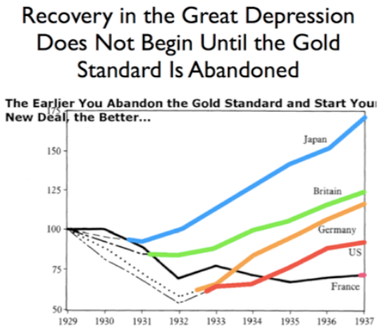
New Deals
Japan: Takahashi Korekiyo
moved early to maintain full employment
Britain: MacDonald-Snowden-Baldwin
Forced off…
Germany: Adolf Hitler
Succeeds Bruening
America: Franklin Delano Roosevelt
Succeeds Herbert Hoover
France: Leon Blum

Slide 55
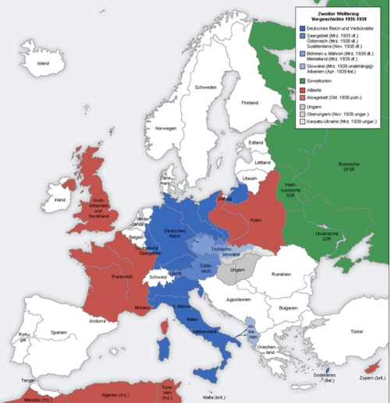
Lecture: World War II
Adolf Hitler took Malthus seriously:
“Germany has an annual increase in population of nearly nine hundred thousand souls. The difficulty of feeding this army of new citizens must grow greater from year to year and ultimately end in catastrophe.... There were four ways of avoiding so terrible a development…”
Birth control? That’s worse…
Agricultural productivity? Limited effect…
Export manufactures? “Unhealthy”—and incredibly risky given the British fleet…
“Living space”: Conquest and demographic replacement
Germany in a long-run fight for world domination with:
Britain
Russia
America
China? India?

Slide 56
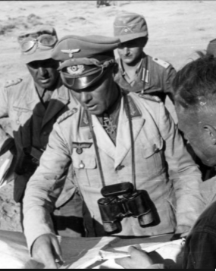
W.H. Auden
From “September 1, 1939,” by W.H. Auden:
I sit in one of the dives
On Fifty-second Street
Uncertain and afraid
As the clever hopes expire
Of a low dishonest decade:
Waves of anger and of fear
Circulate over the bright
And darkened lands of the earth,
Obsessing our private lives;
The unmentionable odor of death
Offends the September night.
Accurate scholarship can
Unearth the whole offence
From Luther until now
That has driven a culture mad,
Find what occurred at Linz,
What huge imago made
A psychopathic god:
and the public know
What all schoolchildren learn,
Those to whom evil is done
Do evil in return...

Slide 57
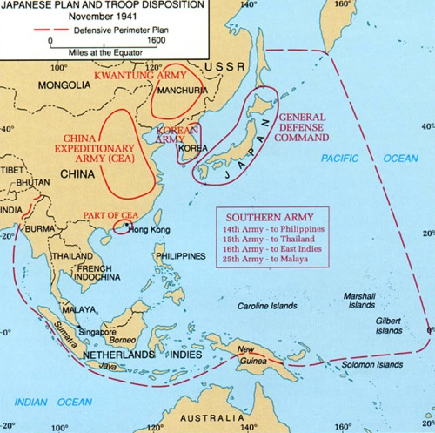
The Greater East Asia Co-Prosperity Sphere
Korea and Taiwan
Manchukuo
The Marco Polo Bridge
Khalkin Gol
The attack on China
The move into Indochina
The oil embargo
Let’s attack two superpowers!
Repel their counterattacks
And then negotiate

Slide 58
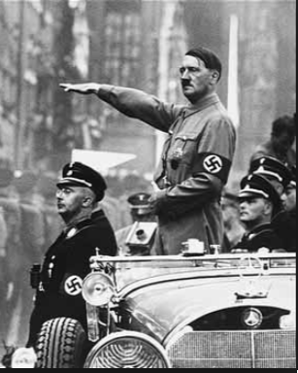
A Popular Hitler
The German economy recovered rapidly.
But peaceful spending-fueled recovery was not what Hitler thought his regime was about.
His regime was about German rearmament
The victorious allies of World War I faced a knotty foreign policy problem.
The isolationist United States was uninterested in sending soldiers and garrisons to Europe.
The British and French electorates definitely did not want to do World War I again.
And Hitler’s program of rearmament and national self-assertion demanded that Britain and France make a choice.
The Westphalian sovereignty principle
Adjustment of national borders to correspond to linguistic groupings
People should be ruled from a capital where people spoke the same language that they did
Rearmament
Rhineland
The Soviet threat
Anschluss

Slide 59
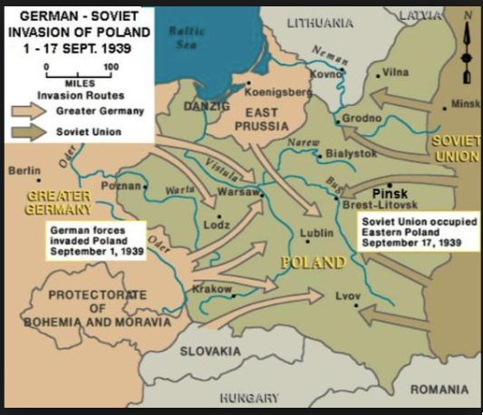
Munich to Warsaw
Munich
March 1939
The bloodless conquest of Czechoslovakia
The guarantees to Poland and Romania
Striking an alliance between Britain, France, and the Soviet Union
What do the fascists want, comrade? They want to exploit us, comrade?
The Hitler-Stalin pact
Britain and France rise to the challenge…

Slide 60
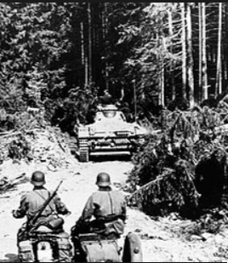
Blitzkrieg!
Nazis tactically superior: 2-1 to 5-1 tactical/operational casualty rates
Nazis operationally superior:
French armored divisions:
1st out of gas
2nd assembly areas overrun
3rd and General Huntziger
4th and de Gaulle
Find large groups of your soldiers overwhelmed, surrounded, cut off, out of supply, fleeing in panic and forced to surrender
The last such episode took place in December 1944: the Nazi Fifth Panzer Army surrounded and forced the surrender of nearly the entire U.S. 106th Infantry Division in the Schnee Eifel of the Ardennes Forest

Slide 61
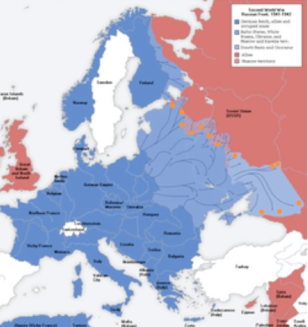
Strategy!
October 1942
Notice those five Nazi armies way off to the right?
Oil
Stalingrad
Operations Mars and Uranus
Mars a total and expensive failure
Uranus a success
The Nazis could not afford any strategic lapses

Slide 62
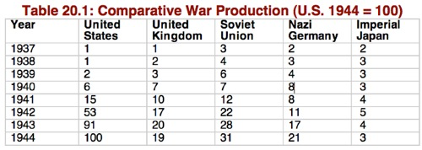
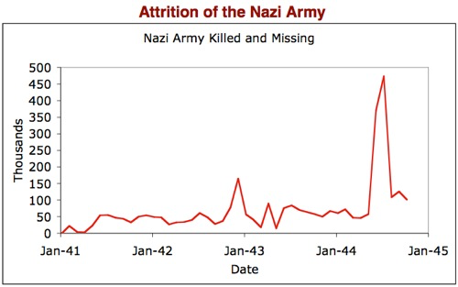
Logistics!
The Nazis could not afford any strategic lapses
Outproduced 7 to 1
Lose the Battle of the Atlantic
Nevertheless, what if the Soviet Union had not held?
What we owe to:
The soldiers of the Red Army
The workers of Magnitogorsk
The peasants of the Volga River valley

Slide 63
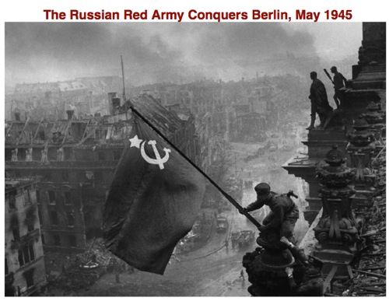
The Cost of WWII
People
European Jews: 6M (70%) (1/3 of them Poles, 1/3 Soviet citizens)
Poland: 6M (16%) (1/3 of them Jews)
Soviet Union: 26M (13%)
Germany: 8M (10%)
Japan: 2.7M (4%)
China: 10M (2%)
France: 600K (1%)
Italy: 500K (1%)
Britain: 400K (1%)
United States: 400K (0.3%)
Material damage extensive: WWI 2 years’ production of European combatants. WWII more like 4 years’ ex-US…

Slide 64
What-Ifs?
What if Franklin D. Roosevelt had decided in the spring of 1941 that with Europe ablaze it was unwise for the U.S. to try to use an economic embargo of militarily-necessary oil to pressure Japan to withdraw from Indochina and reach a peace agreement with China?
What if the British and French governments been willing to use force to remove Hitler when he occupied the Rhineland in 1936, or threatened Czechoslovakia in 1938?
What if Stalin had allied with Britain and France in 1939?
What if anyone other than Winston Churchill had become British Prime Minister in 1940?
What if Hitler had not declared war on the United States in 1941?

Slide 65
Constraints
It is not likely that Hitler would have refrained from attacking Russia in any possible universe.
The need to do so was buried too deeply in his world view to be denied.
The Manhattan project and the allied nuclear weapons monopoly would have been decisive no matter what…

Slide 66
Consequences
U.S. absolute predominance…
Britain is in enormous eclipse…
Soviet Union controls Eastern Europe…
By 1949, Mao controls China…
Germany and Japan in ruins…

Slide 67
Takeaways from This Time
Alternatives: Lecture & Chs. 11 & 13
Give me five…

Slide 68
What Was Unconvincing Today?
Mistakes and unclarities: typos, wordos, and mindos…
In the DRAFT textbook?
In the lecture?

Slide 69
Catch Our Breath…
Ask a couple of questions?
Make a couple of comments?
Any more readings to recommend?

